Slide 1
CSE 4109: Artificial Intelligence
Introduction to Fuzzy Logic Systems
M.M.A. Hashem, PhD
Professor,
Dept. of Computer Science and Engineering
Khulna University of Engineering & Technology (KUET)
Khulna 9203, Bangladesh
Email; hashem@cse.kuet.ac.bd
Cell Phone: +880 1714 003949
CSE 4109: Artificial Intelligence, CSE, KUET

Slide 2
Traditional (crisp) logic
In 300 B.C. Aristotle formulated the law of the excluded middle, which is now the principle foundation of mathematics.
X must be in a set of A or in a set of not A.
CSE 4109: Artificial Intelligence, CSE, KUET

Slide 3



Traditional (crisp) logic
A rose is either RED or not RED.
CSE 4109: Artificial Intelligence, CSE, KUET

Slide 4

Traditional (crisp) logic
What about this rose?
CSE 4109: Artificial Intelligence, CSE, KUET

Slide 5
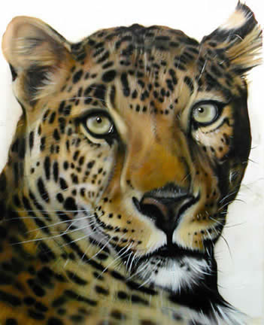
What color is this leopard?
CSE 4109: Artificial Intelligence, CSE, KUET

Slide 6

Is this glass full or empty?
CSE 4109: Artificial Intelligence, CSE, KUET

Slide 7

A tall guy
Where do tall people start?
CSE 4109: Artificial Intelligence, CSE, KUET

Slide 8
What is fuzzy logic?
Fuzzy logic is a superset of conventional (Boolean) logic that has been extended to handle the concept of partial truth -- truth values between "completely true" and "completely false".
* http://www.cs.tamu.edu/research/CFL/fuzzy.html
CSE 4109: Artificial Intelligence, CSE, KUET

Slide 9
What is fuzzy logic?
A type of logic that recognizes more than simple true and false values. With fuzzy logic, propositions can be represented with degrees of truthfulness and falsehood. For example, the statement, today is sunny, might be 100% true if there are no clouds, 80% true if there are a few clouds, 50% true if it's hazy and 0% true if it rains all day.
Fuzzy logic has proved to be particularly useful in expert system and other artificial intelligence applications. It is also used in some spell checkers to suggest a list of probable words to replace a misspelled one.
*http://webopedia.internet.com/TERM/f/fuzzy_logic.html
CSE 4109: Artificial Intelligence, CSE, KUET

Slide 10
Fuzzy Logic
“ A form of knowledge representation suitable for notions that cannot be defined precisely, but which depend upon their context. It enables computerized devices to reason more like humans”
* http://www.fuzzylogic.co.uk/
CSE 4109: Artificial Intelligence, CSE, KUET

Slide 11
Classical Set (Crisp)
Contain objects that satisfy precise properties of membership.
  Example: Set of heights from 5 to 7 feet
1 x A
χ (x) = {
A
0 x A
Characteristic Function
1
0
5
6
7
X (height)
CSE 4109: Artificial Intelligence, CSE, KUET

Slide 12
Fuzzy Set
Contain objects that satisfy imprecise properties of membership
  Example : The set of heights in the region around 6 feet
μ (x) Ε {0-1}
Membership Function
1
A
0
5
6
7
X (height)
CSE 4109: Artificial Intelligence, CSE, KUET

Slide 13
Fuzzy Logic: Motivations
Alleviate difficulties in developing and analyzing complex systems encountered by conventional mathematical tools.
Observing that human reasoning can utilize concepts and knowledge that do not have well-defined, sharp boundaries.
CSE 4109: Artificial Intelligence, CSE, KUET
*Fuzzy Logic: Intelligence, Control, and Information - J. Yen and R. Langari, Prentice Hall 1999

Slide 14
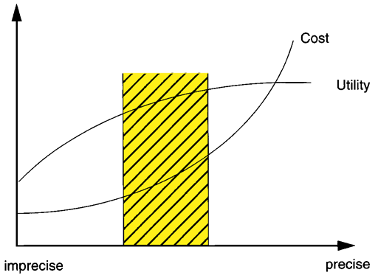
Fuzzy Logic: Motivations
CSE 4109: Artificial Intelligence, CSE, KUET
*Fuzzy Logic: Intelligence, Control, and Information - J. Yen and R. Langari, Prentice Hall 1999

Slide 15
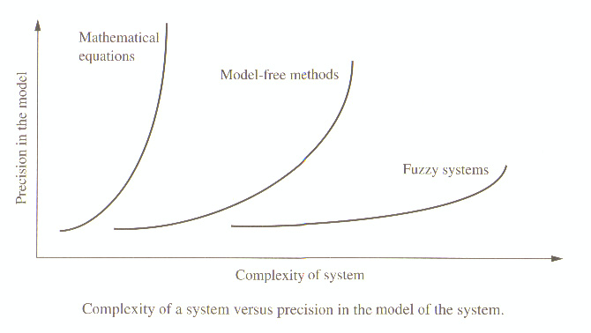
Fuzzy Logic: Motivations
CSE 4109: Artificial Intelligence, CSE, KUET
*Fuzzy Logic with Engineering Applications, Timothy J. Ross, Prentice Hall 1995

Slide 16
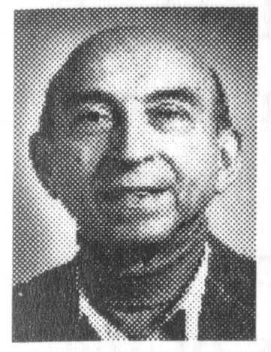
History of Fuzzy Logic
1964: Lotfi A. Zadeh, UC Berkeley, introduced the paper on fuzzy sets.
  Idea of grade of membership was born
  Sharp criticism from academic community
    Name!
    Theory’s emphasis on imprecision
  Waste of government funds!
CSE 4109: Artificial Intelligence, CSE, KUET
*Fuzzy Logic: Intelligence, Control, and Information - J. Yen and R. Langari, Prentice Hall 1999

Slide 17
History of Fuzzy Logic
1965-1975: Zadeh continued to broaden the foundation of fuzzy set theory
  Fuzzy multistage decision-making
  Fuzzy similarity relations
  Fuzzy restrictions
  Linguistic hedges
1970s: research groups were form in JAPAN
CSE 4109: Artificial Intelligence, CSE, KUET
*Fuzzy Logic: Intelligence, Control, and Information - J. Yen and R. Langari, Prentice Hall 1999

Slide 18
History of Fuzzy Logic
1974: Mamdani, United Kingdom, developed the first fuzzy logic controller
1977: Dubois applied fuzzy sets in a comphrensive study of traffic conditions
1976-1987: Industrial application of fuzzy logic in Japan and Europe
1987-Present: Fuzzy Boom
CSE 4109: Artificial Intelligence, CSE, KUET
*Fuzzy Logic: Intelligence, Control, and Information - J. Yen and R. Langari, Prentice Hall 1999

Slide 19
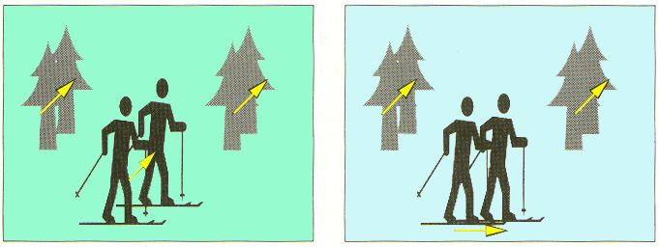
Fuzzy Logic Applications
Image Stabilization via Fuzzy Logic
“If all motion vectors are almost parallel and their time differential is small, then
the hand jittering is detected and the direction of the hand movement
is in the direction of the moving vectors”.
CSE 4109: Artificial Intelligence, CSE, KUET
*Fuzzy Logic: Intelligence, Control, and Information - J. Yen and R. Langari, Prentice Hall 1999

Slide 20
Fuzzy Logic Applications
Aerospace
  Altitude control of spacecraft, satellite altitude control, flow and mixture regulation in aircraft deiceing vehicles.
Automotive
  Trainable fuzzy systems for idle speed control, shift scheduling method for automatic transmission, intelligent highway systems, traffic control, improving efficiency of automatic transmissions
CSE 4109: Artificial Intelligence, CSE, KUET

Slide 21
Fuzzy Logic Applications (Cont.)
Business
  Decision-making support systems, personnel evaluation in a large company
Chemical Industry
  Control of pH, drying, chemical distillation processes, polymer extrusion production, a coke oven gas cooling plant
CSE 4109: Artificial Intelligence, CSE, KUET

Slide 22
Fuzzy Logic Applications (Cont.)
Defense
  Underwater target recognition, automatic target recognition of thermal infrared images, naval decision support aids, control of a hypervelocity interceptor, fuzzy set modeling of NATO decision making.
Electronics
  Control of automatic exposure in video cameras, humidity in a clean room, air conditioning systems, washing machine timing, microwave ovens, vacuum cleaners.
CSE 4109: Artificial Intelligence, CSE, KUET

Slide 23
Fuzzy Logic Applications (Cont.)
Financial
  Banknote transfer control, fund management, stock market predictions.
Industrial
  Cement kiln controls (dating back to 1982), heat exchanger control, activated sludge wastewater treatment process control, water purification plant control, quantitative pattern analysis for industrial quality assurance, control of constraint satisfaction problems in structural design, control of water purification plants
CSE 4109: Artificial Intelligence, CSE, KUET

Slide 24
Fuzzy Logic Applications (Cont.)
Manufacturing
  Optimization of cheese production.
Marine
  Autopilot for ships, optimal route selection, control of autonomous underwater vehicles, ship steering.
Medical
  Medical diagnostic support system, control of arterial pressure during anesthesia, multivariable control of anesthesia, modeling of neuropathological findings in Alzheimer's patients, radiology diagnoses, fuzzy inference diagnosis of diabetes and prostate cancer.
CSE 4109: Artificial Intelligence, CSE, KUET

Slide 25
Fuzzy Logic Applications (Cont.)
Mining and Metal Processing
  Sinter plant control, decision making in metal forming.
Robotics
  Fuzzy control for flexible-link manipulators, robot arm control.
Securities
  Decision systems for securities trading.
CSE 4109: Artificial Intelligence, CSE, KUET

Slide 26
Fuzzy Logic Applications (Cont.)
Signal Processing and Telecommunications
  Adaptive filter for nonlinear channel equalization control of broadband noise
Transportation
  Automatic underground train operation, train schedule control, railway acceleration, braking, and stopping
CSE 4109: Artificial Intelligence, CSE, KUET

Slide 27
Fuzzy logic & probability theory
Suppose you are seated at a table on which rest two glasses of liquid.
  First glass is described : “having a 95% chance Of being healthful and good”
  Second glass is described : “having a .95 membership in the class of healthful and good”
Which glass would you select, keeping in mind that the first glass has a 5 % chance of being filled with nonhealthful liquids, including poisons [Bezdek 1993]?
CSE 4109: Artificial Intelligence, CSE, KUET

